Slide 1

Optimizing Gym Utilization
Table of contents
Group 6
01
02
Introduction & Problem Statement
Group Fitness Class Utilization
03
04
Gym Equipment Utilization
Key Takeaways & Next Steps

Slide 2

Table of contents
01
02
03
04
Optimizing Gym Utilization
Introduction & Problem Statement
Group Fitness Class Utilization
Group 6
Key Takeaways & Next Steps
Gym Equipment Utilization

Slide 3
01
Introduction & Problem Statement

Slide 4
Introduction
Problem Statement
GoodLife Fitness aims to enhance gym utilization to maximize client satisfaction and profitability.
The company faces two key challenges:
GoodLife Fitness is the largest fitness club chain in Canada, founded in 1979.
It operates over 400 locations across the country.
Provides a wide range of fitness services, including personal training, group fitness classes, and premium gym facilities.
Group Fitness Class Utilization
Gym Equipment Utilization
Some fitness classes are always fully booked but experience low attendance rates
Gym crowd levels fluctuate throughout the day, impacting equipment availability and customer experience

Slide 5
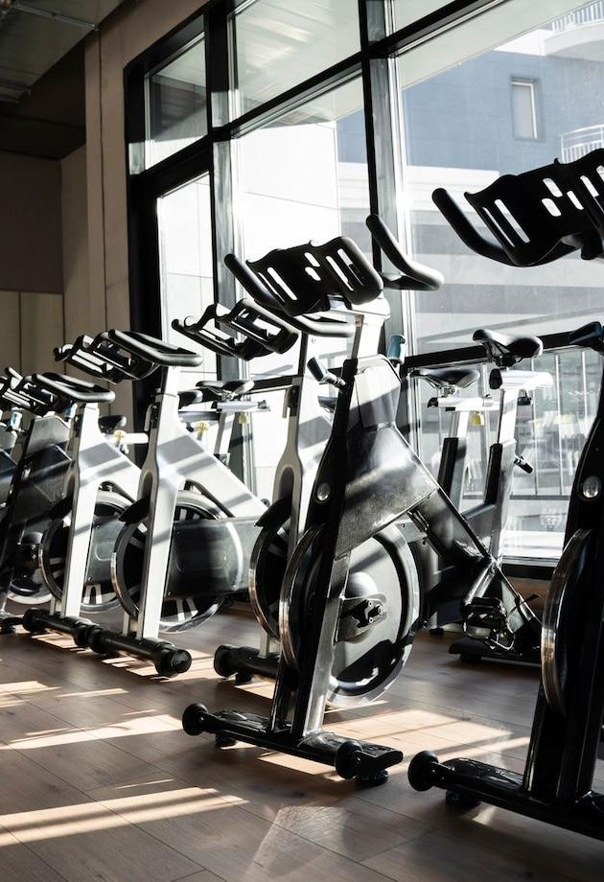
Problem Statement
Introduction
GoodLife Fitness aims to enhance gym utilization to maximize client satisfaction and profitability.
The company faces two key challenges:
02
GoodLife Fitness is the largest fitness club chain in Canada, founded in 1979.
It operates over 400 locations across the country.
Provides a wide range of fitness services, including personal training, group fitness classes, and premium gym facilities.
Group Fitness Class Utilization
Group Fitness Class Utilization
Gym Equipment Utilization
Some fitness classes are always fully booked but experience low attendance rates
Gym crowd levels fluctuate throughout the day, impacting equipment availability and customer experience

Slide 6
02
Group Fitness Class Utilization

Slide 7
Group Fitness Class Utilization
Methodology & Approach
Data Exploration
Feature Engineering
Modeling
Business Integration
Analyze booking data (months_as_member, weight, days_before, etc.)
Check for class imbalances and correlations
Create and transform features
Explore interaction effects between features
Build binary classification models (logistic regression, decision trees, etc.)
Evaluate using metrics like accuracy, precision, recall, and ROC-AUC
Set thresholds on prediction probabilities
Conduct cost-benefit analysis to mitigate false predictions
Objective:
Predict member attendance for booked fitness classes.
Enable dynamic allocation of class capacity.
Why It Matters :
Increase the number of available spots.
Minimize under-utilized class spaces.
Enhance member experience by reducing overcrowding or empty spots.

Slide 8

Methodology & Approach
03
Gym Equipment Utilization
Data Exploration
Feature Engineering
Modeling
Business Integration
Analyze booking data (months_as_member, weight, days_before, etc.)
Check for class imbalances and correlations
Create and transform features
Explore interaction effects between features
Build binary classification models (logistic regression, decision trees, etc.)
Evaluate using metrics like accuracy, precision, recall, and ROC-AUC
Set thresholds on prediction probabilities
Conduct cost-benefit analysis to mitigate false predictions
Group Fitness Class Utilization
Objective:
Predict member attendance for booked fitness classes.
Enable dynamic allocation of class capacity.
Why It Matters :
Increase the number of available spots.
Minimize under-utilized class spaces.
Enhance member experience by reducing overcrowding or empty spots.

Slide 9
Steps To Prepare Model
1. Data Extraction
2. Data Preprocessing
Handling Missing Values
Handling Inconsistent Data
3. Exploratory Data Analysis
4. Handling Class Imbalance
5. Model Selection

Slide 10
Data Extraction
Data consists of 1500 rows and 8 columns
Data Preprocessing
Missing Values - Weight column had 20 missing values which were replaced with median
Inconsistent Data – Data in ‘days_before’ , ‘day_of_week’, ‘category’ were handled

Slide 11
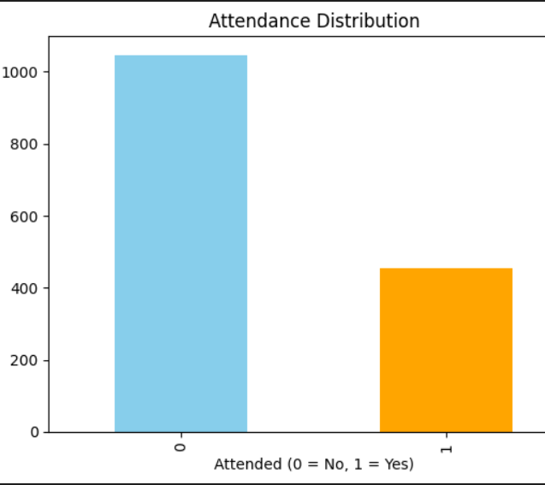
EDA
Distribution of attendance
The graph indicates a class imbalance, with a higher number of instances for class 0 (Not attended) compared to class 1 (Attended).

Slide 12
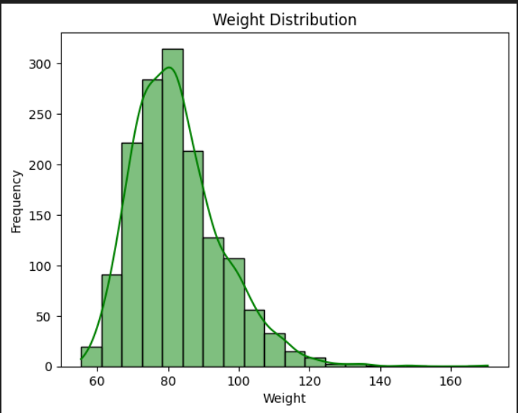
Distribution Of Weight
Most weights are concentrated between 60 and
100 units.

Slide 13
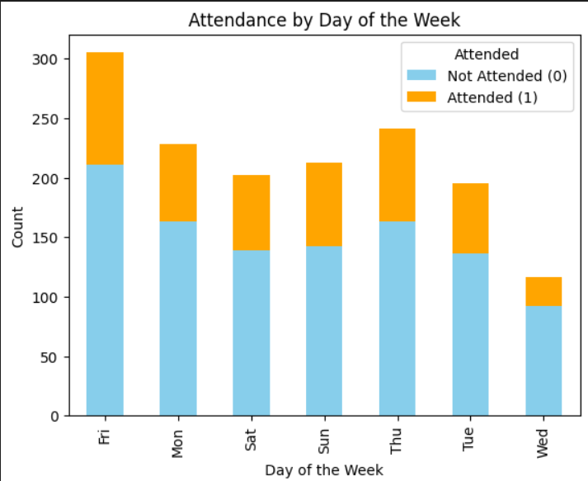
Attendance by day of the week
The chart shows Friday had the highest overall attendance while Wednesday had the lowest.
Across all days, the count of those who did not attend (0) is consistently higher than those who did (1).

Slide 14
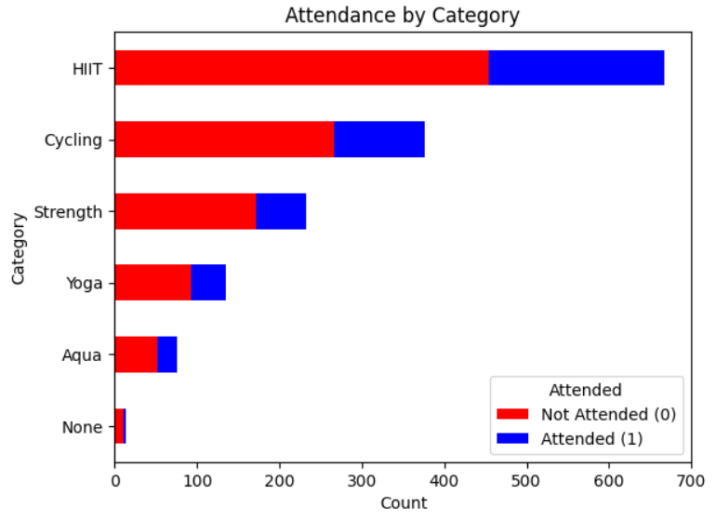
Attendance by category
The HIIT category had the highest participation and non-attendance overall, while Strength and Cycling also saw notable engagement.
Attendance was generally lower across all categories compared to non-attendance.

Slide 15
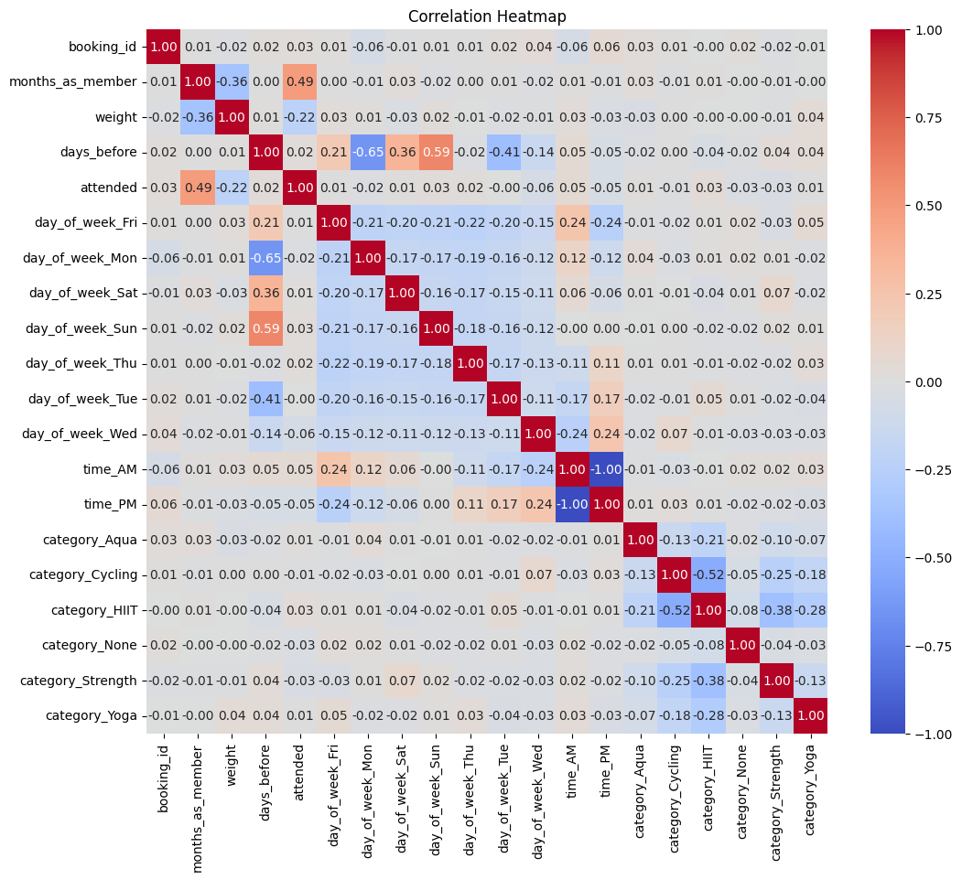
Correlation Heatmap

Slide 16
Strongest Positive Correlations :
attended vs months_as_member: 0.49 — moderate positive correlation; longer membership is slightly associated with higher attendance.
days_before vs day_of_week_Sun: 0.59 — bookings made earlier might be more likely on Saturdays.
Moderate Negative Correlations:
category_Cycling vs category_Strength: -0.25
category_Cycling vs category_HIIT: -0.52
category_Strength vs category_HIIT: -0.38
These indicate that users generally tend to prefer one category over another.

Slide 17
Class Imbalance
A significant class imbalance is observed in the attended column, with 0 (Not attended) having 1046 instances and 1 (Attended) having 454 instances.
Applied SMOTE (Synthetic Minority Oversampling Technique) to address the class imbalance . This technique generates synthetic samples for the minority class to balance the dataset.
Before Resampling: (1500 rows , 8 columns)
After Resampling: (2092 rows , 20 columns)

Slide 18
ML Models
XGBoost demonstrated the best performance, achieving a balance between precision and recall, making it the most suitable model for predicting attendance.
This predictive capability can help GoodLife optimize class utilization by identifying potential no-shows and opening up additional spots for other members, ultimately improving customer satisfaction and operational efficiency.
ML Model | Accuracy
Logistic Regression | 83%
Random Forest | 83%
XG Boost | 86%

Slide 19
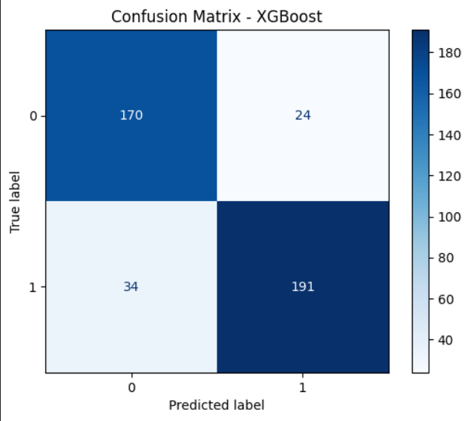
True Positive – 191
True Negative - 170
False Negative – 34
False Positive - 24

Slide 20
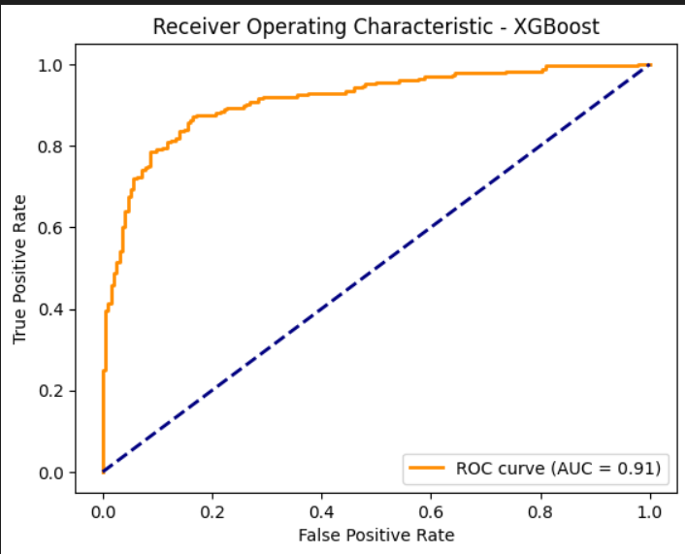
AUC (Area Under the Curve) = 0.91 A value of 0.91 indicates that the model is quite effective at distinguishing between the two groups

Slide 21
03
Gym Equipment Utilization
Methodology & Approach
Data Exploration
Feature Engineering
Modeling
Business Integration
Analyze booking data (months_as_member, weight, days_before, etc.)
Check for class imbalances and correlations
Create and transform features
Explore interaction effects between features
Build binary classification models (logistic regression, decision trees, etc.)
Evaluate using metrics like accuracy, precision, recall, and ROC-AUC
Set thresholds on prediction probabilities
Conduct cost-benefit analysis to mitigate false predictions

Slide 22
Gym Equipment Utilization
Methodology & Approach
Data Exploration
Feature Engineering
Modeling
Business Integration
Visualize attendance patterns and identify trends or seasonality
Evaluate the impact of external factors (temperature, holidays, etc.)
Extract date/time components
Develop lag features to capture temporal dependencies
Regression Models: Linear regression, tree-based methods
Time Series Forecasting: ARIMA/SARIMA or LSTM for temporal dynamics
Inform staffing, maintenance, and targeted promotions based on forecasted crowd levels
Objective:
Predict the number of gym-goers to optimize equipment usage.
Enable proactive management of gym capacity.
Data Elements:
Historical counts (every 10 minutes over the last year)
Additional features: weather, time, holidays, semester info.

Slide 23
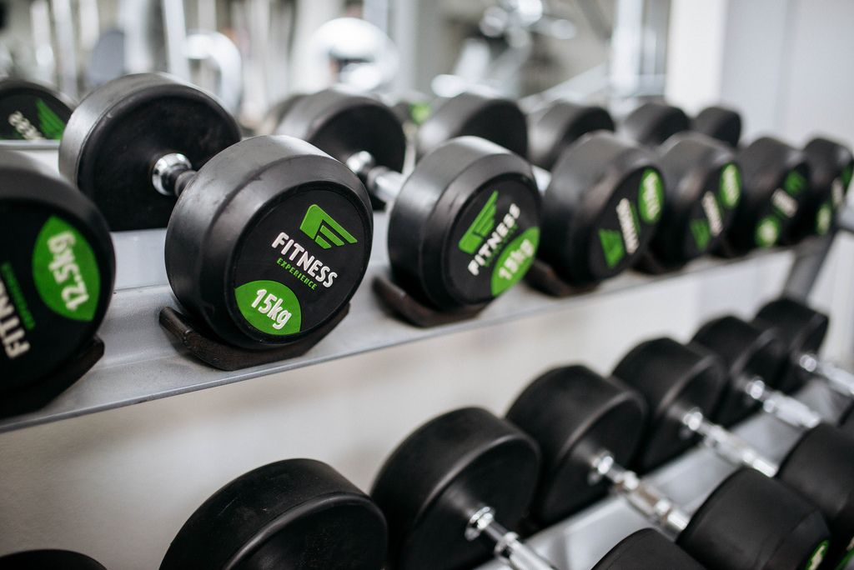
Methodology & Approach
04
Key Takeaways & Next Steps
Data Exploration
Feature Engineering
Modeling
Business Integration
Visualize attendance patterns and identify trends or seasonality
Evaluate the impact of external factors (temperature, holidays, etc.)
Extract date/time components
Develop lag features to capture temporal dependencies
Regression Models: Linear regression, Random Forest,
XGBoost and feature importance using XGBoost
Inform staffing, maintenance, and targeted promotions based on forecasted crowd levels
Gym Equipment Utilization
Objective:
Predict the number of gym-goers to optimize equipment usage.
Enable proactive management of gym capacity.
Data Elements:
Historical counts (every 10 minutes over the last year)
Additional features: weather, time, holidays, semester info.

Slide 24
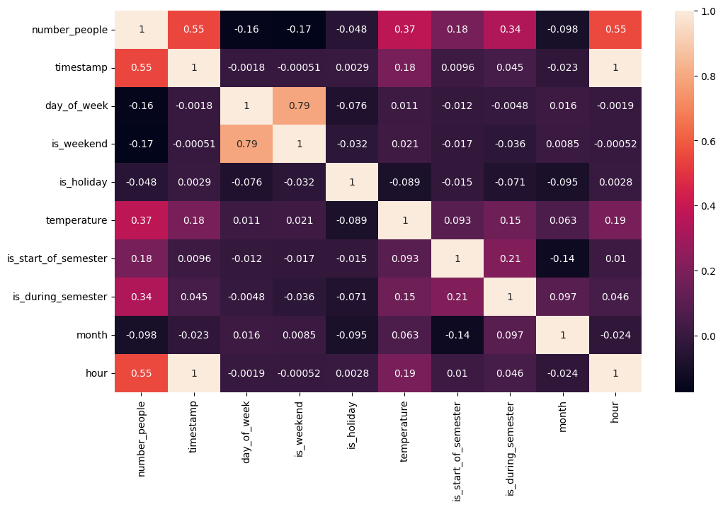
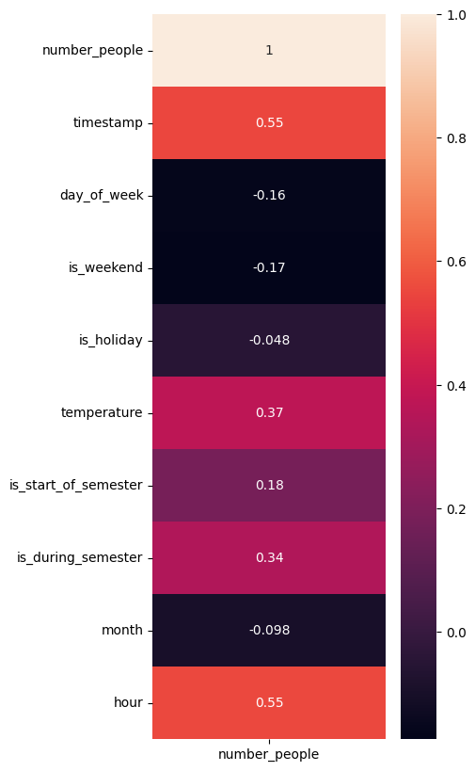
Correlation Matrix

Slide 25
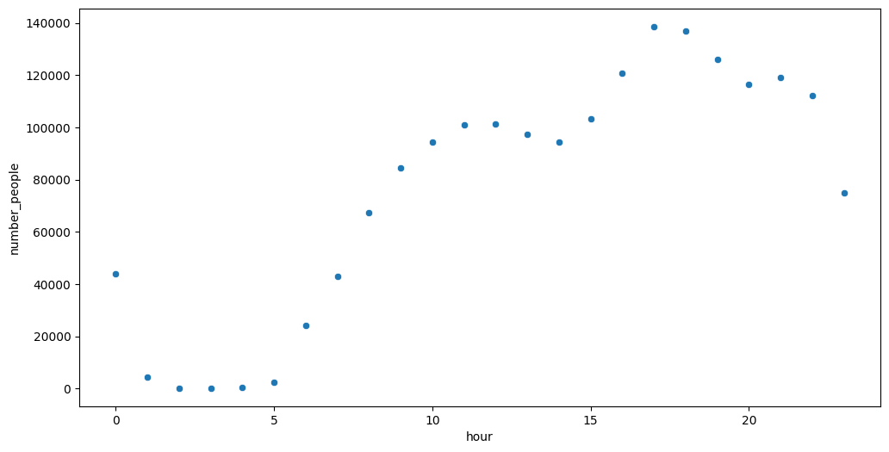
People Per Hour

Slide 26
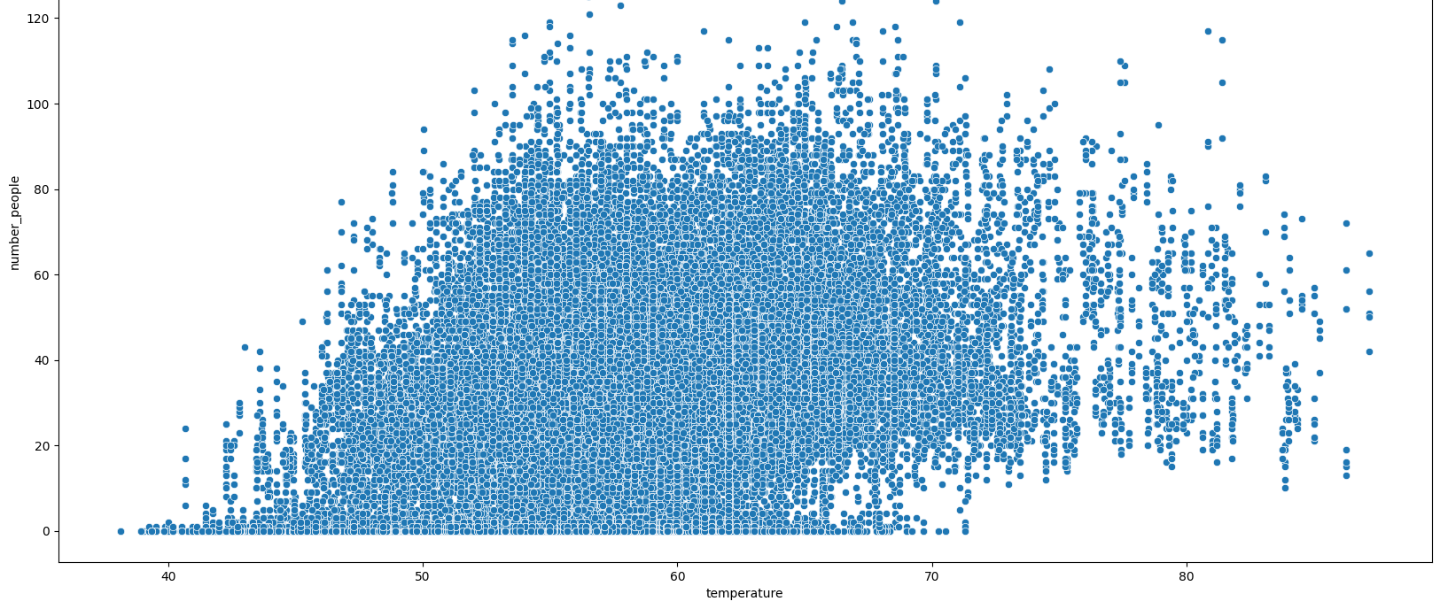
Temperature & Number of people

Slide 27
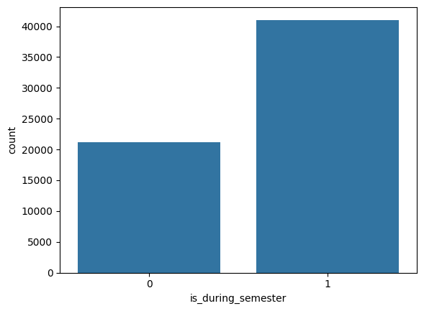
Is_during_semester & Number of people

Slide 28
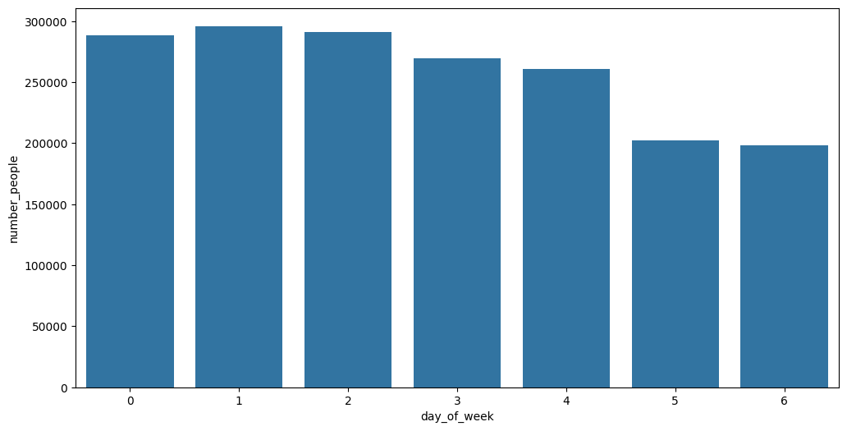
People Per Day

Slide 29
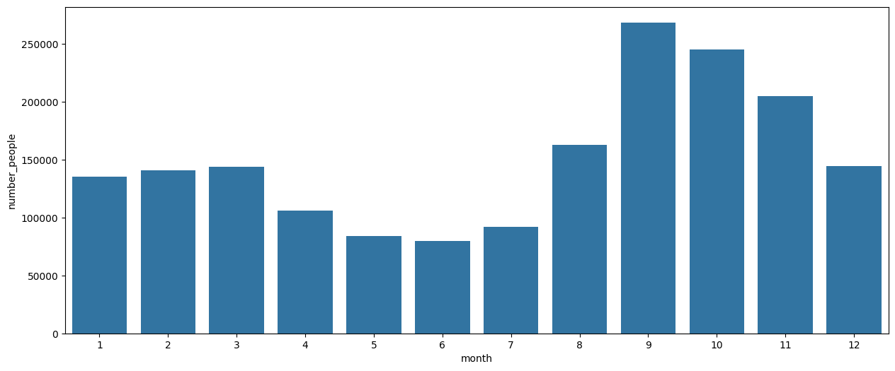
People Per Month

Slide 30
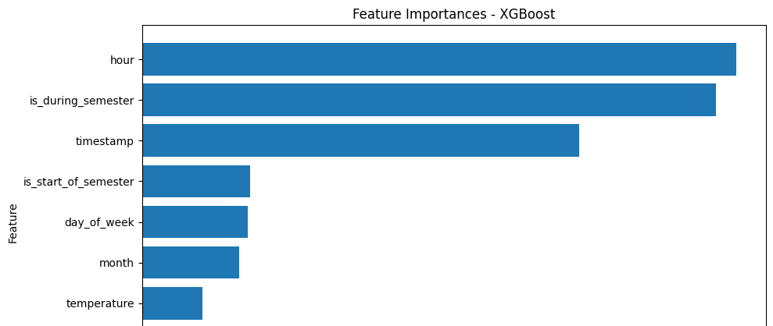
Feature Importance

Slide 31
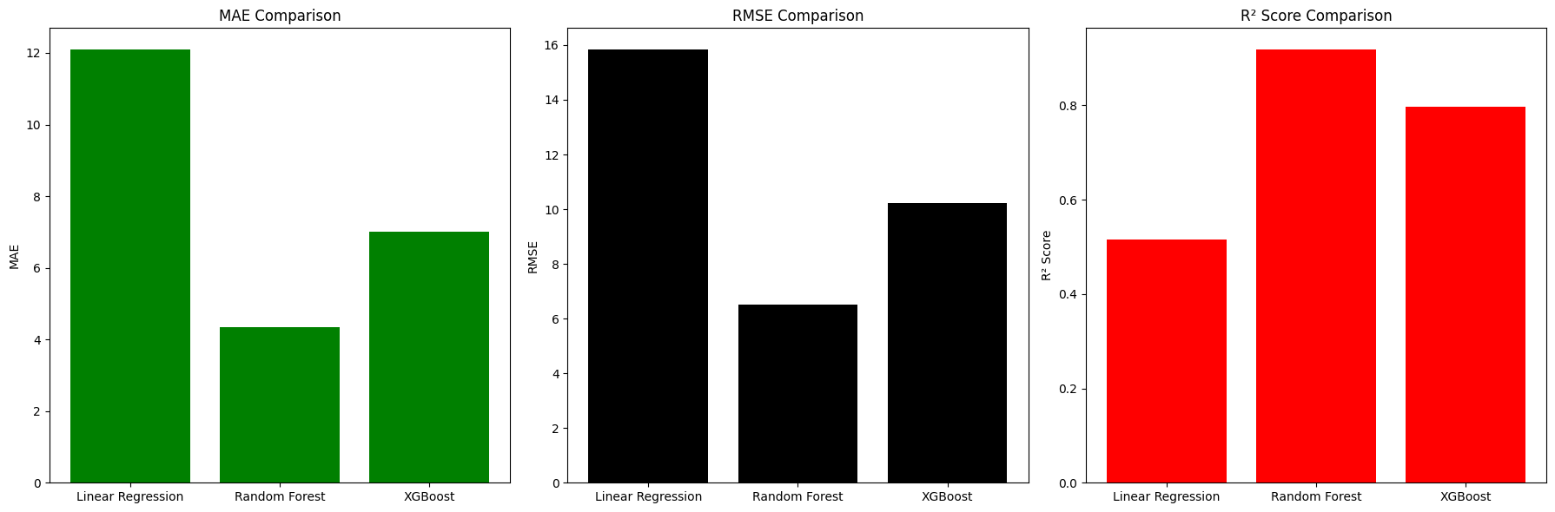
Model Comparison

Slide 32
04
Key Takeaways & Next Steps

Slide 33
Key Takeaways & Next Steps
Key Takeaways:
Data-driven approach can help optimize capacity and enhance customer satisfaction.
Predictive models can support dynamic resource allocation in both group classes and gym equipment usage.
Next Steps:
Refine data preprocessing and feature engineering.
Test and validate multiple modeling approaches.
Integrate predictive models into GoodLife’s operational systems.
Continuously update models with new data for sustained performance.
Thanks!

Slide 34
Thanks!
Key Takeaways & Next Steps
Key Takeaways:
Data-driven approach can help optimize capacity and enhance customer satisfaction.
Predictive models can support dynamic resource allocation in both group classes and gym equipment usage.
Next Steps:
Refine data preprocessing and feature engineering.
Test and validate multiple modeling approaches.
Integrate predictive models into GoodLife’s operational systems.
Continuously update models with new data for sustained performance.

